Slide 1

Cybersecurity Project
Cisco Internship
Submitted by:
Avanish Sanghvi
RA1811033010075
SRM Institute of Science and Technology, Kattankulathur

Slide 2
Aim
Design secure network for your institution, SRM Institute of Science and Technology, Kattankulathur.

Slide 3
Proposed Network Infrastructure
Individuals Servers for:
IT Services/Dept.
Accounts’ Dept.
Administration
Faculties
Students
The email and web servers (Main Server) will be configured in the IT.
Each switch will be given a name to the network they are assigned to.

Slide 4
Devices Used
Server
Switches
Routers
Computers (PCs)
Laptop
Smartphones

Slide 5
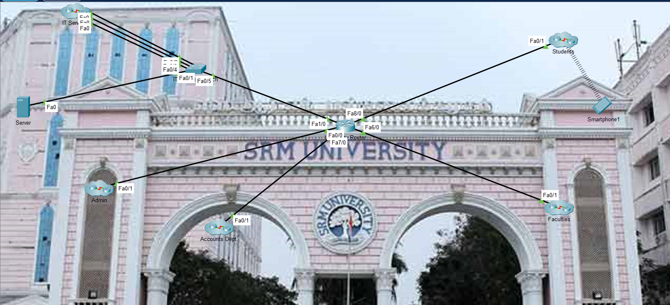
Network Infrastructure

Slide 6
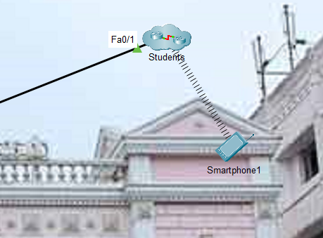
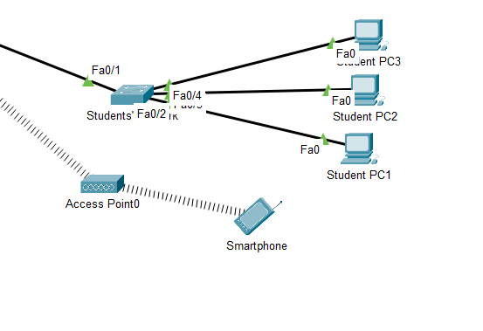
Cluster Network

Slide 7
Explanation
In the Cisco Packet Tracer file attached, a simple yet efficient way to design and hence secure network for my institute has been presented.
Any institution will have a wide range of users in it.
Students, Faculty members, IT service providers etc.
To meet with all these department needs, setting up a common and yet secure network over the institution perimeter is a challenging job.

Slide 8
continued...
In this, there will be a wide variety of end devices where usage of internet at the same time will be expected/demanded.
To meet with all these, a main Server, the device which shall be responsible for completing the connection with the ISP shall be placed at the main building.
Furthermore, the IT, Accounts, Administration, Faculties, and last but not the least Students’ separate servers have been deployed.
This has been done to avoid hassle and have a smooth network up and running at all times.

Slide 9
continued...
As soon as a server is deployed, further, routers, switched; according to the needs of that particular department has been deployed.
Each secure enough to handle network traffic.
Firewalls at each node for every department is being proposed. A firewall is more of a necessity. Without these, a network system is open to threats from different areas.

Slide 10
continued...
The network testing was successfully completed.
Using ‘ping’ commands, devices over the network were able to communicate with each other.
We were able to also send & hence receive emails from different departments over the network. This was an additional service being added to the network design.
The list of email addresses can be found in the server.

Slide 11
continued...
Each Server of a department has been secured with usernames (here, cisco) and passwords (here, password) to ensure that proper authentication is carried out before the user is allowed to access the internet.
Server ip address : 192.168.0.5
Domain : srmist.edu.in

Slide 12
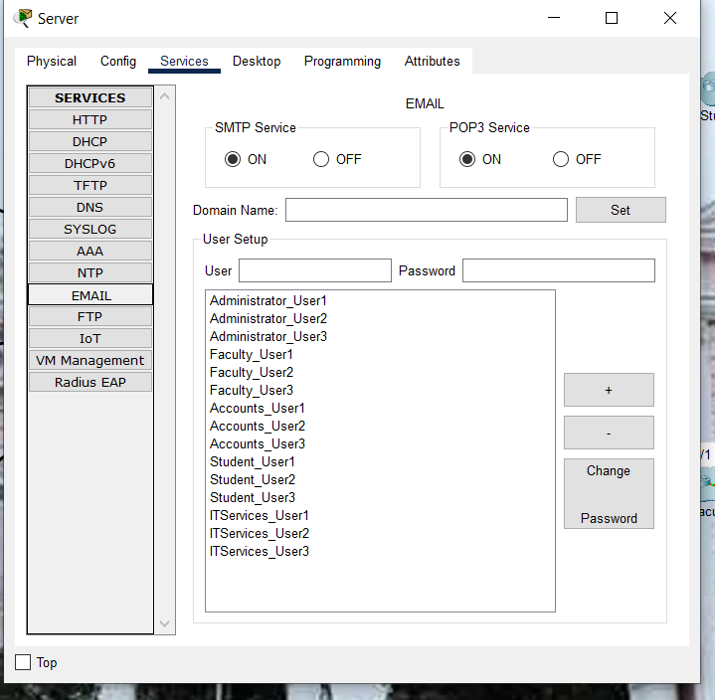

Slide 13
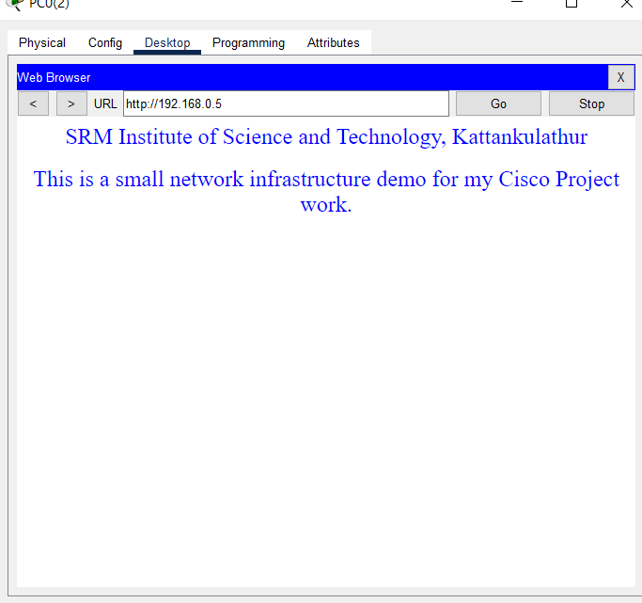
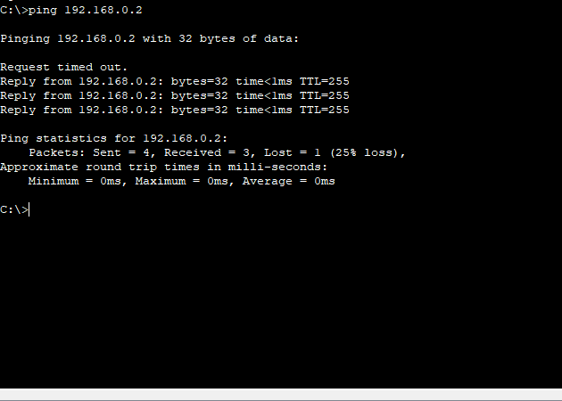
Connection

Slide 14
Types of Attacks (expected)
Endpoint attacks—gaining unauthorized access to user devices, servers or other endpoints, typically compromising them by infecting them with malware.
Malware attacks—infecting IT resources with malware, allowing attackers to compromise systems, steal data and do damage. These also include ransomware attacks.
Vulnerabilities, exploits and attacks—exploiting vulnerabilities in software used in the organization, to gain unauthorized access, compromise or sabotage systems.
Advanced persistent threats—these are complex multilayered threats, which include network attacks but also other attack types.
In a network attacks, attackers are focused on penetrating the corporate network perimeter and gaining access to internal systems. Very often, once inside attackers will combine other types of attacks, for example compromising an endpoint, spreading malware or exploiting a vulnerability in a system within the network.

Slide 15
continued...
Unauthorized Access
Distributed Denial of Service (DDoS) Attacks
Man-in-the-Middle Attacks
Code and SQL Injection Attacks
Privilege Escalation
Insider Threats

Slide 16
Vulnerabilities (expected)
Lack of Data Backup.
Use of weak passwords by users over the network.
Wireless devices (especially smartphones) will be very vulnerable and more prone to attacks over the network.
Other IoT based devices (if in use) might be another vulnerability added to the network.

Slide 17
Security Features
Secure console (we set a password on the console to begin securing the devices)
  Passwords protect the higher line-levels
  The ‘enable password’ or ‘enable secret’ command is used to set a global encrypted password that protects the Privileged Exec mode.
  Service password-encryption encrypts passwords in the config.
Secure command lines
Secure remote access for all devices over the network (using Telnet or SSH)
  Configuring SSH is the more secure option/way ahead since:
    Hostname is required
    Domain name required
    Crypto key-gen RSA

Slide 18
Solution
Securing your network is all about keeping personal data secure from others. All of the methods and plans presented here are free and do not cost money, so it would be silly not to put these plans into place to protect yourself. Thinking about getting hacked via your network feels like being robbed or burglarized and leaving your network and router open and available to that threat is naive.
Take the proper steps to protect yourself wherever possible!

Slide 19
continued...
Enable encryption on your access point.
Make sure that you leave no OPEN PORTS since these are additional vulnerabilities.
Install a network firewall.
Install firewalls on network devices.
Set the router access password.
Disable MAC Address filtering on your Access Point or router.
Disable remote login.
Disable wireless administrating.

Slide 20
continued...
Change default login passwords and usernames.
Use strong and unique passwords.
Monitor for unknown device connections.
Turn the network off when not in use.
Increase wireless security.
Use the strongest encryption protocol available.
Adjust factory-default configurations on software and hardware.

Slide 21
THANK YOU!

